Slide 1
Data visualization
24.06.2022

Slide 2
Misleading Visualizations
Data scrubbing:- Raw data can often be very rough in form, and the temptation when creating a visualization is to remove some of the roughness. Outlier removal is a common tactic in this situation.
Unless there is reason to believe that the outliers resulted from flaws in the data acquisition process, they should not be removed without informing the viewer and providing the option for the outliers to be displayed.
Unbalanced scaling:- Scaling is a powerful tool in visualization, since careful selection of scale factors can reveal patterns and structures not visible in unscaled views. However, scaling can be used to deceive the viewer into believing that a trend is stronger or weaker than supported by the data.

Slide 3
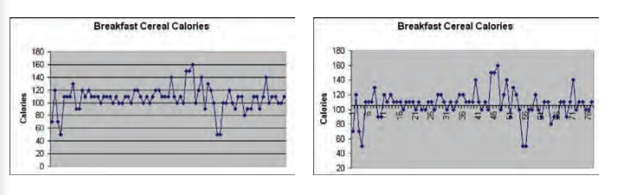
Contd.
Range distortion:- As mentioned in an earlier section, viewers often have an expectation about the ranges for a particular data dimension; by setting this range to be significantly different from this expectation, the user may be deceived into misinterpretation.
Abusing Dimensionality:- mapping a scalar value to a graphical attribute such as volume can dramatically increase the likelihood of erroneous interpretation.

Slide 4
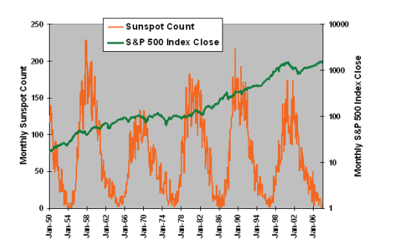
Visual non-sense – comparing apple and oranges
Visualizations are designed to convey information, and it is important that the information be meaningful. Visualizations are often created by combining data sets from different sources.
However, It is easy to combine unrelated components into a single visualization and identify what seems to be structure; for example, plotting stock market values against occurrences of sunspots.
In this case, coincidental relationships can be confused with causal relationships. In deciding what data to combine, it is important to first ensure that there is some logic in the combination.

Slide 5
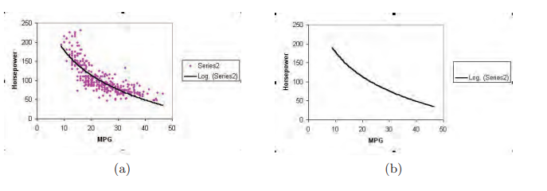
Raw versus Derived Data
In some visualizations, it is common practice to throw out all of the raw data and only show the smooth approximation derived from that data.
This forces the viewer to trust that the approximation is an accurate portrayal of the data, which is often not the case when the designer blindly applies statistical fitting algorithms.
It is best to show both the raw data and the fitted model first, and to allow one or the other to be deemphasized or filtered out on demand.

Slide 6
Absolute versus Relative Judgment
Humans have a fairly limited ability to make absolute judgments of visual stimuli. This implies that visualizations that depend too heavily on users performing accurate measurements of graphical attributes such as position, length, and color will result in problems in interpretation.
One means of combating this human limitation is to design visualizations that either rely on relative rather than absolute judgment, or that are restricted to only using a small number of distinct values for each graphical attribute being used to convey information.
Bounding boxes, grids, and tick marks are all excellent tools for converting an absolute judgment task to one that depends more on relative judgment.

Slide 7
Comparing and Evaluating Visualization Techniques
“Which visualization technique(s) should I use to solve my problem?” In general, there is no simple answer to this question; many factors go into the evaluation process, such as the specific task or tasks the user wishes to accomplish, the characteristics of the data, and the user’s level of experience in using visualization to help solve problems.
Another common problem that is often avoided by developers of visualization techniques is to determine under what conditions their technique is better than existing techniques, or whether a modification made to a particular method improves or makes worse some aspect of the technique or system.

Slide 8
n this chapter we attempt to identify some of the components and procedures necessary to assess and compare the effectiveness of visualization techniques
User Tasks: To perform a valid assessment of a particular visualization technique, or to compare two or more techniques, it is important to identify the specific actions or tasks that one wishes to accomplish with the assistance of visualization.
• identify—to recognize an object based on the characteristics presented, such as finding a fracture in an x-ray;
• locate—to establish the position of an object, such as determining the location of maximal stress in structural analysis;
• distinguish—to determine that an object is distinct or different from another, such as separating elevations that exceed a given threshold from those below the threshold;
• categorize—to classify objects into distinct types, such as different land cover or material types

Slide 9
CONTD.
• cluster—to group similar objects based on some relationship. A related action is to segment, which consists of separating dissimilar objects;
• rank—to place a group of objects in an order, such as numerical or chronological;
• compare—to examine the similarities and differences between two or more objects, where ordering is not possible, such as masking the intersection of two data sets to reveal how they differ;
• associate—to draw a relationship between two or more objects, such as linking temperature and location in weather maps;
• correlate—to find a causal or reciprocal relationship between two or more objects, such as determining the relationship between interest rates and economic growth.

Slide 10
Users characteristics
Besides the tasks to be performed, the effectiveness of a visualization technique is tightly associated with the users of the visualization. Users can be classified based on their knowledge and skills.
Familiarity with domain: How much expertise does the user have with the domain of the data being explored? Has she studied the field for a long time, or is she relatively new to the field?
Familiarity with task: How much experience has the user had in performing the desired task? Is she an expert or a novice, or somewhere in between? Note that this differs from the previous point, as someone could have significant domain experience, but minimal experience in a particular task.

Slide 11
contd.
Familiarity with data: Has the user examined this data previously and formed a reasonable mental model of its contents, or is this her first exposure to it? Is it similar to other data sets she has examined?
Familiarity with the visualization technique: Is this the user’s first attempt to interpret the data using this particular kind of visualization, or has she spent considerable time using the technique?
Familiarity with the visualization environment: Has the user employed the particular tool in the past, or is it her first exposure? This differs from the previous factor, as a visualization technique can be implemented in several different packages, and aspects of the packages themselves can influence the effectiveness of the exploration of the data.

Slide 12
Data Characteristics
The characteristics of the data being visualized can have a profound influence on the effectiveness of the visualization technique, and they must be considered in the evaluation process.
Type:- Floating point, numbers, strings – All combinations has to be tested.
Size:- Tests should cover normal sizes and extreme sizes as well.
Dimensionality:- it is generally useful to test a visualization with all possible subsets of dimensions
Structure:- Tables, grids, Hierarchy – all have to tested.
Range:- Testing should involve exercising the entire range of possible values, including
the extremes of the range.

Slide 13
Visualization charectistics
Computational performance: How quickly can the visualization be generated, using data sets of various sizes?
Memory performance: How much computer memory is required to generate the visualization?
Data limitations: What are the upper and lower bounds for the size and complexity of the data that can be visualized with this technique?
Degree of complexity: What is the normal learning curve for the technique? How many parameters does the user need to set in order to generate views?
Degree of usability: How easy is it to perform the task? How intuitive is the interpretation of the visualization? How intuitive are the controls for interactions?
Degree of accuracy: How frequently is the user successful or unsuccessful in performing the desired task with this technique?

